Slide 1
Professional Curiosity Resource Pack sharing learning and improving practice

Slide 2
With thanks to Swindon Safeguarding Partnership for sharing their professional curiosity resource pack on which this is based.
Information within this resource pack has been collated from a number of safeguarding partnerships including Waltham Forest, Manchester and Norfolk Safeguarding Adults Board.
With special thanks to Waltham Forest for use of some of their materials and East Sussex County Council Adult Social Care and Health Professional Curiosity Checklist.

Slide 3
How to use this resource
This resource pack aims to raise awareness of professional curiosity and how being professionally curious is necessary to fully understand a situation and the risks an adult may face, which are not always immediately obvious.
The expectation is that you will share the resource pack and use it:
in team meetings
as part of group/individual supervision or for your own development
You can look at it as a whole or dip in or out of it at your convenience.
Navigation bar – dip in/out
What is professional curiosity?
Top Tips
Watch/Listen to films
Scenarios to discuss
Action for you
Resources

Slide 4
What is professional curiosity?
It is the capacity and communication skill to explore and understand what is happening with a family/adult rather than making assumptions or accepting things at face value.
It can require practitioners to think ‘outside the
box’, beyond their usual professional role, and
consider the circumstances holistically.
Curious professionals engage with individuals
and families through visits, conversations,
observations and asking relevant questions to
gather historical and current information.

Slide 5
What is professional curiosity?
It is a combination of looking, listening, asking direct questions, checking out and reflecting on information received. It means:
Testing out your professional hypothesis and not making assumptions.
Triangulating information from different sources to gain a better understanding of individuals and family functioning.
Getting an understanding of individuals’ and families’ past history which in turn, may help you think about what may happen in the future.
Obtaining multiple sources of information and not accepting a single set of details you are given at face value.
Having an awareness of your own personal bias and how that affects how you see those you are working with.
Being respectively nosey.

Slide 6
Why is it important?
Professional curiosity is a golden thread through Partnership Learning Reviews and audits and is an essential part of safeguarding. Nurturing professional curiosity is a fundamental aspect of working together to keep children, young people and adults safe.
A lack of professional curiosity can lead to:
Missed opportunities to identify less obvious indicators of vulnerability or significant harm
Assumptions made in assessments of needs and risk which are incorrect and lead to wrong intervention for individuals and families
The presenting issues are dealt with in isolation

Slide 7
Why is it important?
A high reliance by professionals on self-reporting by parents/carers/adults brings with it significant risks of proceeding on false information.
Professionals asking questions and seeking explanation from parents/carers is something to be valued; healthy challenge is good and can provide assurance that your assessment of the situation is accurate.
Good information sharing, supervision and open discussion at key decision-making meetings to ‘check and test’ information can be crucial in ensuring this does not happen.

Slide 8
Is exercising professional curiosity easy and straightforward?
Not always, especially if working with families and individuals who demonstrate disguised compliance (attempt to maintain the appearance of complying with safeguarding plans but do not follow this through with meaningful action) or coercive control.
Families/individuals may appear to engage with professionals but are not able or willing to change as a result of an intervention.
Some families are unable through fear to be open and honest about family dynamics.
In these cases professionals will need to exercise professional curiosity.

Slide 9
Top Tips
LOOK
LISTEN
ASK
CHECK OUT

Slide 10
Top Tips
LOOK
Is there anything about what you see when you meet with this child/adult/family which prompts questions or makes you feel uneasy?
Are you observing any behaviour which is indicative of abuse or neglect?
Does what you see support or contradict what you’re being told?

Slide 11
Top Tips
LISTEN
Are you being told anything which needs further clarification?
Are you concerned about what you hear family members say to each other?
Is someone in this family trying to tell you something but is finding it difficult to express themselves? If so, how can you help them to do so?

Slide 12
Top Tips
ASK
Are there direct questions you could ask when you meet this child/adult/family which will provide more information about the vulnerability of individual family members? Here are some examples:
How do members of your family deal with conflict?
How do adults in the household respond to stress?
What arrangements are in place for the child or young person to access education?
Who are the professionals working with individual members of your family?
Who is living with you?
Do you feel safe?
Are there people who regularly visit your home apart from those who live there?
Are there any significant events to be aware of – bereavement, previous trauma?

Slide 13
Top Tips
CHECK OUT
Are other professionals involved and have they seen the same as you?
Are professionals being told the same or different things?
Are others concerned? If so, what action has been taken so far and is there anything else which should or could be done by you or anyone else?

Slide 14
Top Tips - Remember to…
Question your own assumptions about how individuals/families function and look out for over optimism
Recognise your own feelings (e.g. tiredness, feeling rushed or illness) and how this might impact on your view of a child/adult/family on a given day
Think about why someone may not be telling you the whole truth – have you spoken to them on their own?
Demonstrate a willingness to have challenging conversations
Address any professional anxiety about how hostile or resistant individual/families might react to being asked direct or difficult questions
Identify approaches you could use and share with your manager

Slide 15
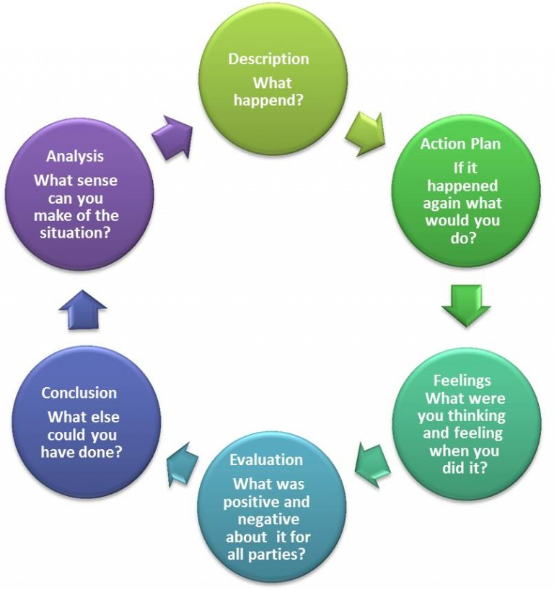
Top Tips - Remember to…
Remain open minded and expect the unexpected
Recognise when individuals/adult repeatedly do not do what they said they would - identify this and discuss with them
Understand the cumulative impact of multiple or combined risk factors, e.g. domestic abuse, drug/alcohol misuse, mental health
Ensure that your practice is reflective and that you have access to good quality supervision

Slide 16
What information do I need to obtain?

Slide 17
Barriers to Professional Curiosity
Important to note: When a lack of professional curiosity is cited as a factor in a tragic incident, this does not automatically mean that blame should be apportioned. It is widely recognised that there are many barriers to being professionally curious. Some of these are set out below.
Disguised compliance
A family member or carer gives the appearance of co-operating with services (any professional) to avoid raising suspicions, to allay professional concerns and ultimately to reduce professional involvement. We need to establish the facts and gather evidence about what is actually happening. We need to focus on outcomes rather than processes to ensure we remain person centred.
The ‘rule of optimism
Professionals applying a “rule of optimism” have been a feature of reviews nationally for many years. The meaning that some professionals attributed to their observations about the family was that they tended to be optimistic and were always thinking the best of families.
Accumulating risk
Seeing the whole picture reviews repeatedly demonstrate that professionals tend to respond to each situation or new risk discretely, rather than assessing the new information within the context of the whole person, or looking at the cumulative effect of a series of incidents and information.

Slide 18
Barriers continued……
Normalisation
This refers to social processes through which ideas and actions come to be seen as 'normal' and become taken-for-granted or 'natural' in everyday life. Because they are seen as ‘normal’ they cease to be questioned and are therefore not recognised as potential risks or assessed as such.
Professional deference
Workers who have most contact with the individual are in a good position to recognise when the risks to the person are escalating. However, there can be a tendency to defer to the opinion of a ‘higher status’ professional who has limited contact with the person but who views the risk as less significant. Be confident in your own judgement and always outline your observations and concerns to other professionals, be courageous and challenge their opinion of risk if it varies from your own.
Escalate any ongoing concerns through your manager and use the Sussex Safeguarding Adults Escalation and Resolution Protocol or the Resolving Professional Differences | Sussex Child Protection and Safeguarding Procedures Manual which provide processes for resolving disagreements between agencies or professionals in relation to adult and children’s safeguarding.

Slide 19
Barriers continued…
Confirmation bias
This is when we look for evidence that supports or confirms our pre-held view, and ignores contrary information that refutes them. It occurs when we filter out potentially useful facts and opinions that don't coincide with our preconceived ideas.
‘Knowing but not knowing’
This is about having a sense that something is not right but not knowing exactly what, so it is difficult to grasp the problem and take action.
Confidence
In managing tension, disagreement, disruption and aggression from families or others, can undermine confidence and divert meetings away from topics the practitioner wants to explore and back to the family’s own agenda.
Dealing with uncertainty
Contested accounts, vague or retracted disclosures, deception and inconclusive medical evidence are common in safeguarding practice. Practitioners are often presented with concerns which are impossible to substantiate. In such situations, ‘there is a temptation to discount concerns that cannot be proved’.

Slide 20
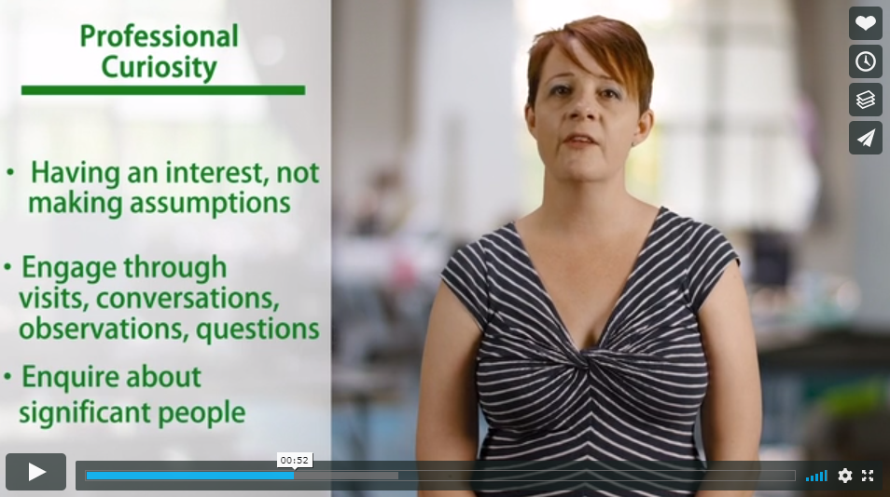
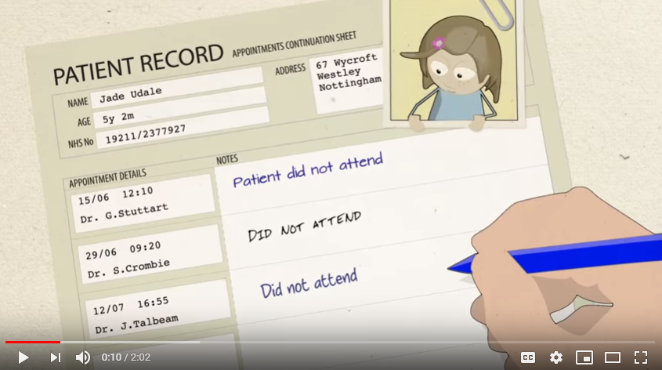
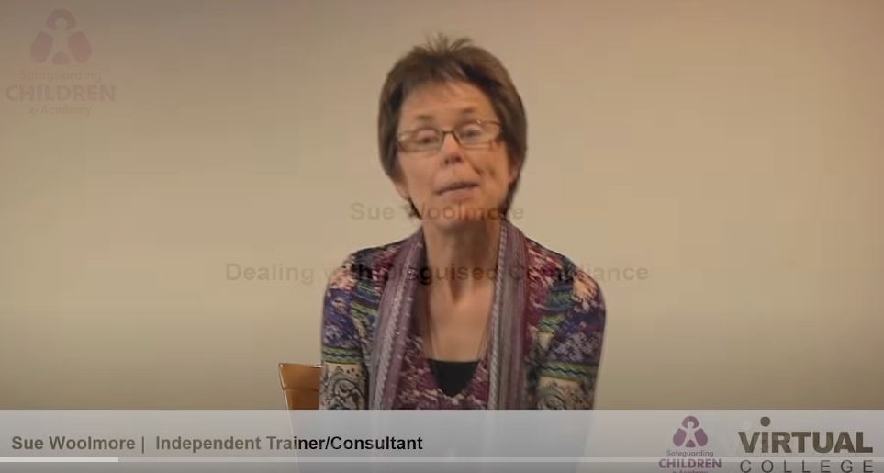
Useful clips to watch/listen to
Bite-size video guide on professional curiosity
Re-thinking did not attend
Disguised Compliance
3 minute clip from Waltham Forest Safeguarding Partnership which provides some context when working with families.
2 minute clip encouraging practitioners to identify children as ‘Was Not Brought’ as opposed to ‘Did Not Attend’ when referring to them not being presented at medical appointments.
(Nottinghamshire Safeguarding Partners )
4 minute clip where Sue Woolmore talks about disguised compliance and the importance of professional curiosity.

Slide 21
Scenarios for you consider
On the next few slides there are 4 scenarios for you to consider, discuss and consider what questions you need to ask? Think about the information you have and what your observations may be indicating . Are there:-
Signs of neglect, physical and emotional signs of potential abuse. What do you need to do next?
Signs of isolation and control being asserted by others which may indicate coercion and control. How can you check this?
Behaviour which suggests the person is not happy being at home or not engaging with services . Explore the reasons behind this.
What are other professionals reporting ? Is this cause for concern?

Slide 22
Discuss this scenario – what questions would you ask?
Bilal aged 15 and lives with his mother, elderly grandparents and 4 younger siblings
Home is a compact four bedroomed house in an area of social deprivation
Bilal shares a room with two younger brothers (twins aged 7) but is often missing from home. This is not always reported by his mother
Although he has no criminal record, Bilal is known to the Police who say that he is a nuisance
School says he is regularly absent. When he does attend, he is late and disruptive in lessons. Bilal never has his PE kit and he goes missing at lunch times. The only time he does seem to engage is at events where lunch is provided. Teachers have noticed that Bilal often looks somewhat dishevelled
Bilal’s mum says she is fed up of the shame her oldest son has brought to the family and that he is good for nothing
A local youth group have banned Bilal from their activities following an incident where he came into the youth club seemingly drunk, disrupted the activities and was suspected to have stolen a coat on his way out.
Bilal appears to have a constant cold and a deep, hacking cough but his GP has not seen him since he was 11 years old.

Slide 23
Discuss this scenario – what questions would you ask?
Alex aged 46 and lives alone
In Alex’s mid-30s, serious health issues resulted in them becoming a wheelchair user, with limited mobility. Alex now has a range of more acute health concerns: muscular spasms, physical impairments and intermittent speech loss
Home is a ground floor one bedroom flat which is very cluttered, not wheelchair friendly and in need of major repairs. Alex likes the flat to be ‘cosy’, with a preference for living in darkness
Alex is well known to health and social care professionals. Capacity assessments concluded that they do have mental capacity
Alex often cancels medical appointments or does not turn up and the last professional that visited the home noticed that medication was stacked up unopened in the kitchen
On a recent admission to hospital following a urine infection, health professionals noticed that Alex was unkempt, underweight and dehydrated
Alex has become isolated from groups of friends and family
Alex has recently lost a lot of weight and is known to self-medicates with alcohol
Alex has started to refuse anyone entry to the home including utility services

Slide 24
Discuss this scenario - what questions would you ask?
Cox family Mum (Cal) aged 38, Dad (Chris) aged 36, Ella aged 6 and Oli aged 2
Home is a spacious two bedroomed flat that is always immaculate
Mum has physical and mental health needs. Dad is her main carer and works full time
Health visitor reports that on the last two visits, she saw Oli and Ella with Dad who explained that Mum was in bed unwell. Healthwise, all seemed well with both children although Ella seemed a little on edge on both occasions
Ella has mentioned to her teachers that Mum and Dad sometimes argue at home and she worries about this
There have been multiple occasions when Ella and Oli have not been brought to health appointments
Mum has missed many of her health appointments, some of which have been cancelled by Dad
Mum puts herself down quite a lot. Since losing her mother whom she was very close to about 5 years ago, she says that she has lost contact with family and friends and often feels isolated
Mum has mentioned that Dad likes things at home to be neat and orderly. She states that he earns the money for the family and creatively manages the budgets e.g. by keeping food locked away - she says she likes to snack and often gets carried away. She says that she is very lucky to have him and that he sometimes reminds her that she would probably not cope without him around

Slide 25
Discuss this scenario - what questions would you ask?
Dina aged 4 and lives at home with Mum, Uncle and two older brothers aged 10 and 15.
Home is a three bedroom flat. Dina sleeps in Mum’s room, her brothers share and Uncle sleeps in the box room. This was previously Dina’s room
Dina’s father left the family home about a year ago and was physically abusive to Mum and Dina’s brothers. Dina often witnessed this
Dina was very close to her dad and has expressed that she misses him
Mum works long hours so as to financially support the family
Mum has a good support network and her brother (Uncle) moved in about 6 months ago. He needed somewhere to live after his relationship broke down and he was able to help Mum with childcare while Mum is working. Dina’s two brother were previously helping with this
School recently noticed bruising around Dina’s thigh when she was changing for P.E. When questioned about it she went very quiet and tried to cover it up
During play time recently, Dina was found touching another girl’s genital area and staff overheard her making sexual references

Slide 26
Adults
East Sussex SAB Professional Curiosity Learning-Briefing
Key findings from analysis of domestic homicide reviews: October 2019 to September 2020
Brighton and Hove SAB-Professional-Curiosity-Learning-Briefing.pdf
Professional Curiosity Podcast – YouTube
Practitioner: professional curiosity insights guide (justiceinspectorates.gov.uk)
Children
NSPCC Learning from case reviews where professional curiosity has been a theme.
Professional-Curiosity-Bulletin-FINAL.pdf (brightonandhovelscb.org.uk)
Safeguarding Practice Reviews ESSCP
Welcome to your Pan Sussex Child Protection and Safeguarding Procedures Manual | Sussex Child Protection and Safeguarding Procedures Manual

